Slide 1

Historical Text Generation
Wesnahika B. Charles

Slide 2

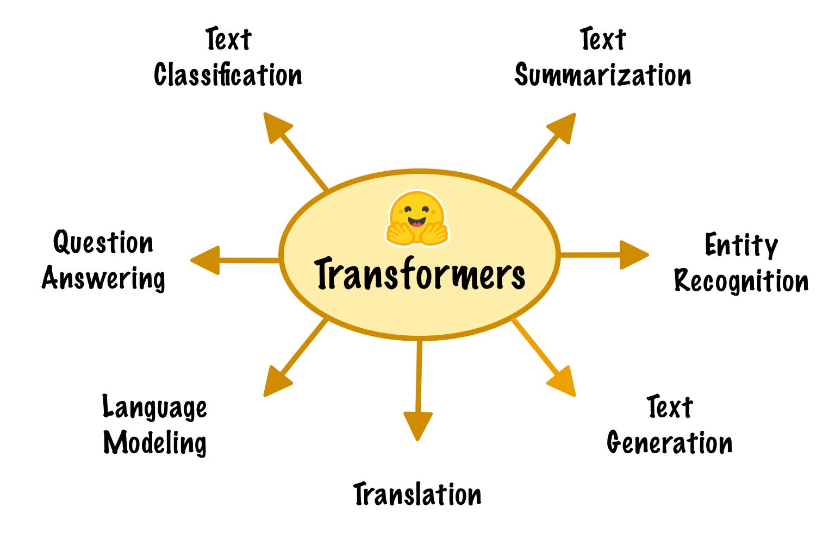
Problem/Method
This project aims to create a transformer based language model that generates historical texts based on year and region. By fine-tuning this model, it trains on a structured dataset which will produce relevant outputs.

Slide 3





DATA COLLECTION

Slide 4
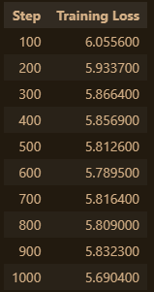
Results and conclusion
Trained on 1000 steps for now.
Perplexity: ~60, which needs some work
Training loss seems to decrease as the steps go on.
When trying to generate an output, I was receiving somewhat coherent sentences, however, it didn’t seem as fluent as I wanted it to be as shown below
Future: Want to increase steps, iteratively as well as broaden my dataset
Future: OCR usage.

